Slide 1



SEG3125: Lab 4
1
Design Principles
Presented by TA Anisha
Faculté de génie | Faculty of Engineering
uOttawa.ca

Slide 2
Deadlines
2
The deadline for lab 4 is February 9 at 11:59PM
This lab is worth 3%

Slide 3
Introduction
3
This lab, we are going to focus on Don Norman’s Design Principles
Visibility
Affordance
Mapping
Consistency
Feedback
Constraints
You are going to use a CSS Framework: Bootstrap

Slide 4
Tutorial
4
Bootstrap 4 Tutorial
https://www.w3schools.com/bootstrap4/default.asp
Don Norman Design Principles
https://medium.com/@sachinrekhi/don-normans-
principles-of-interaction-design-51025a2c0f33

Slide 5
Lab 4 Introduction
5
In this you have the option to choose a service company
from these two options:
Hair Salon/Barbershop
Bicycle Repair Shop
Try to do a paper sketch for your design first
Think about your choice of fonts and colors that match the image you want to project for your website

Slide 6
Lab 4 Design Inspiration
6
Hair Salon/Barbershop
https://hairrepublic.ca/
https://metcalfe-barber-shop.business.site/
https://hairdynamic.ca/
Bike Repair Shop
https://www.atelier-velo.com/
http://www.cycosport.ca/
http://bikemobile.ca/

Slide 7
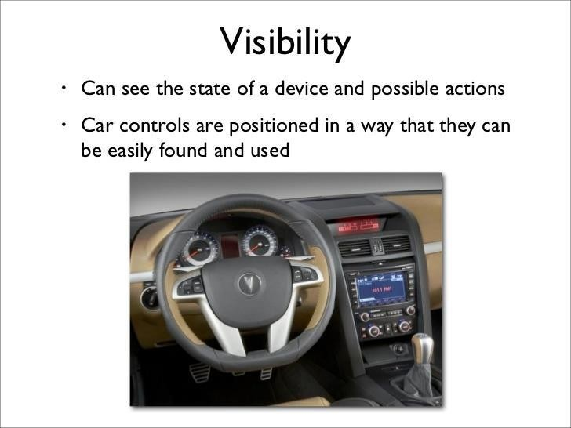
Visibility
7

Slide 8
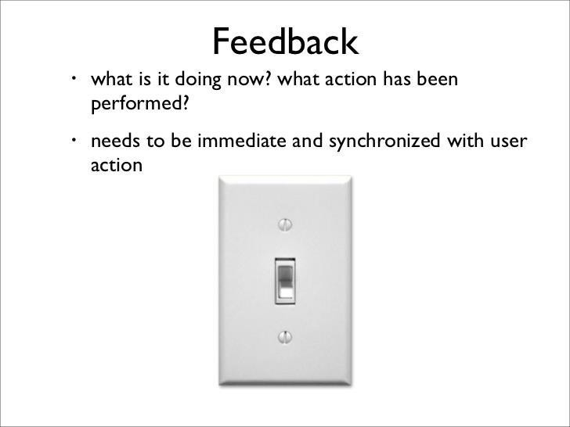
Feedback
8

Slide 9
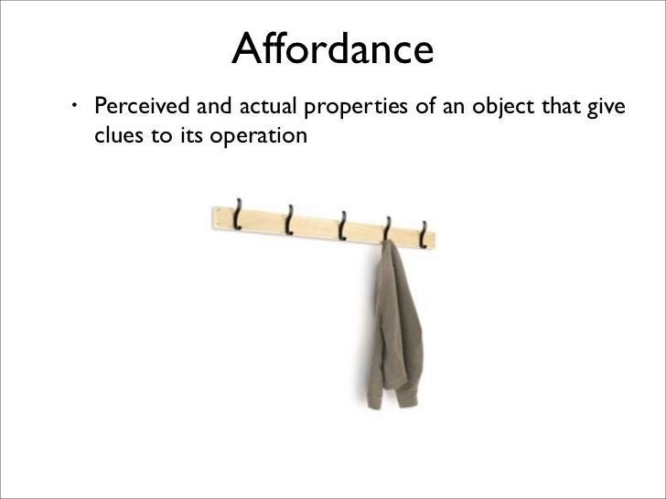
Affordance
9

Slide 10
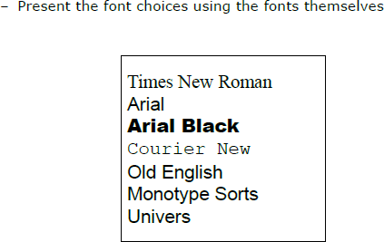
Mapping
10

Slide 11
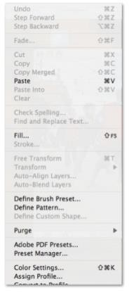
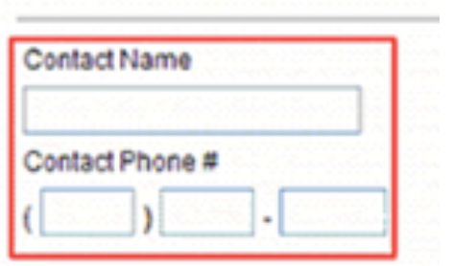
Constraints
11

Slide 12
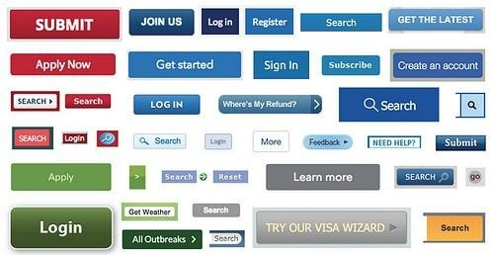
Consistency
12

Slide 13
Requirements
13
You have to use Bootstrap
Users can choose a service and set the date and time
User should be able to provide personal information to book the service
Respect the following Design Principles:
Visibility
Information
Logo
Shop’s address
The services offered and their prices
The staff that provide those services
Actions
Selecting a service
Selecting a date and time
Entering contact information

Slide 14
Requirements
14
Affordance
Use standard components (buttons, lists)
Add "tooltip" for items if necessary (small explanations)
Mapping
Use photos to show short, medium, long, or hair color cuts.
Use photos showing portions of bikes supported by each service (brake repair, puncture, maintenance)
Consistency
Have an aesthetic consistency: Fonts and colors…
Again use Bootstrap components and its color choices for different
messages if they work for your website

Slide 15
Optional Requirements
15
Not much for this lab, but if want, you can make both implementation, the Hair Salon and the Bike Repair Shop.

Slide 16
Starting point
16
Starting point repository
Rendering of the starting point repo

Slide 17
Submissions
17
Add a pdf document in the brightspace lab section link corresponding to the lab whose submission is due.
In Brightspace, In the Lab submission link.
Submit a pdf document consisting of the following: 1)Group number 2)Group members 3)Each members contribution.
4)Link to the Github Repo.
5)Snapshots of the website created

Slide 18
Questions
18
Any questions???
If you have any question, you can send me an email to TAs

Slide 19
THANK YOU!
19

